Slide 1
A Comprehensive Analysis of Machine Learning Algorithms for Breast Cancer Classification Across Diverse Image Modalities
Group 15:
Sabista Ifraj [20301175]
Arpita Roy [23266026]
Sania Azmee Bhuiyan[23266033]
Sohanoor Rahman [23273009]

Slide 2
Introduction
The global impact of breast cancer.
The critical role of early detection.
The significance of machine learning and deep learning in breast cancer classification.
A systematic review to analyze trends, challenges, and advancements.

Slide 3
Dataset Description
Overview of datasets as the foundation for ML/DL models.
Key sources, including academic institutions and hospitals.
Diversity in image modalities and total images.
The importance of considering limitations.
Goal: To identify datasets contributing to robust breast cancer classification.

Slide 4
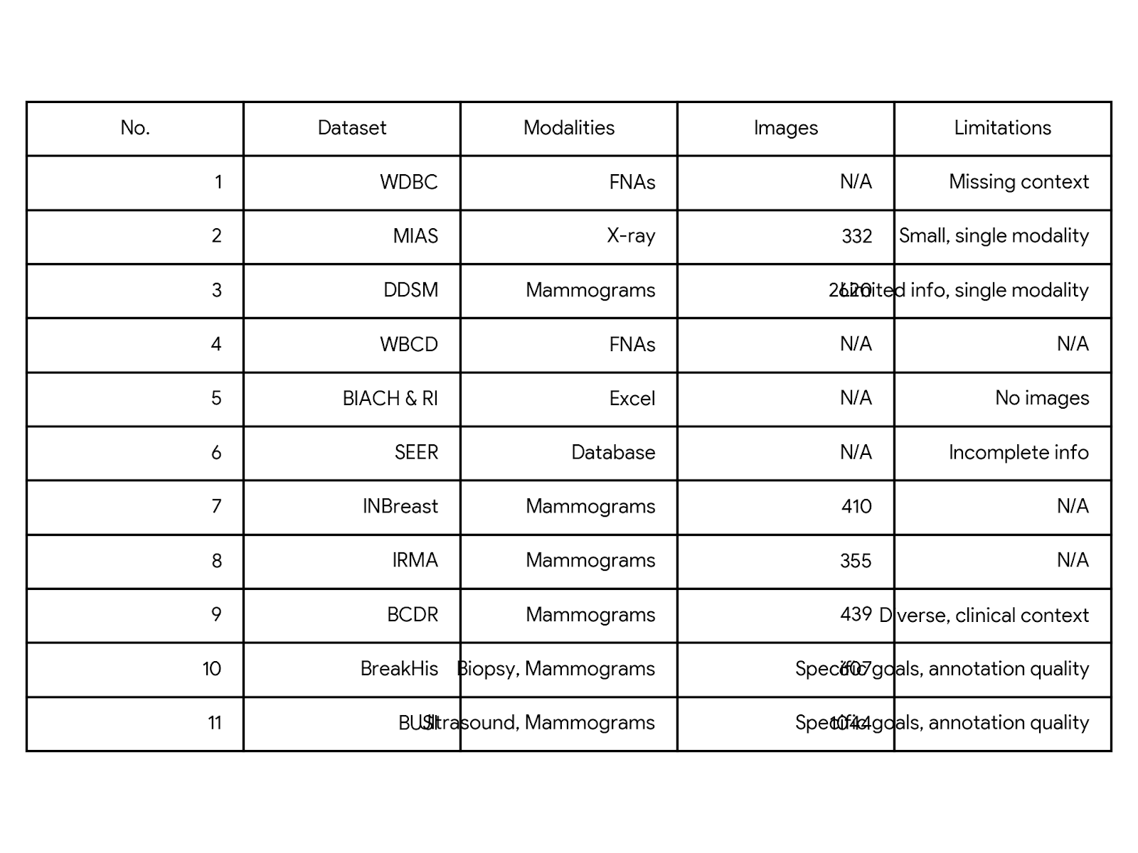
Dataset Characteristic
Dataset characteristics.
Datasets, their sources, and limitations.
The relevance of diverse datasets in research.

Slide 5
Key Findings
Summary of notable findings from the datasets.
Trends, challenges, and advancements.
The importance of accurate breast cancer classification.

Slide 6
Conclusion
Summary of Systematic review
The implementation for Breast Cancer Research and Treatment
Potential Avenue for Future Work and Improvement

